Slide 1



Vojtěch Růžička
@vojtechruzicka
vojtechruzicka.com

Slide 2

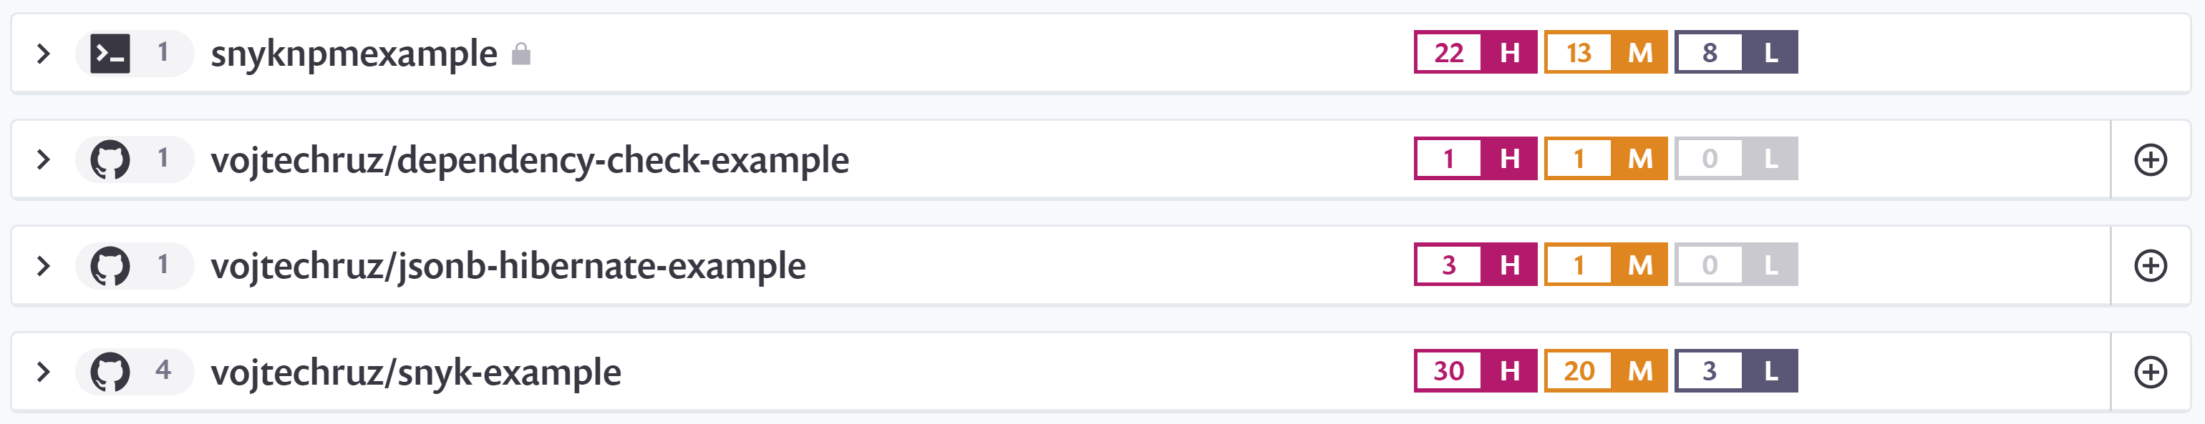
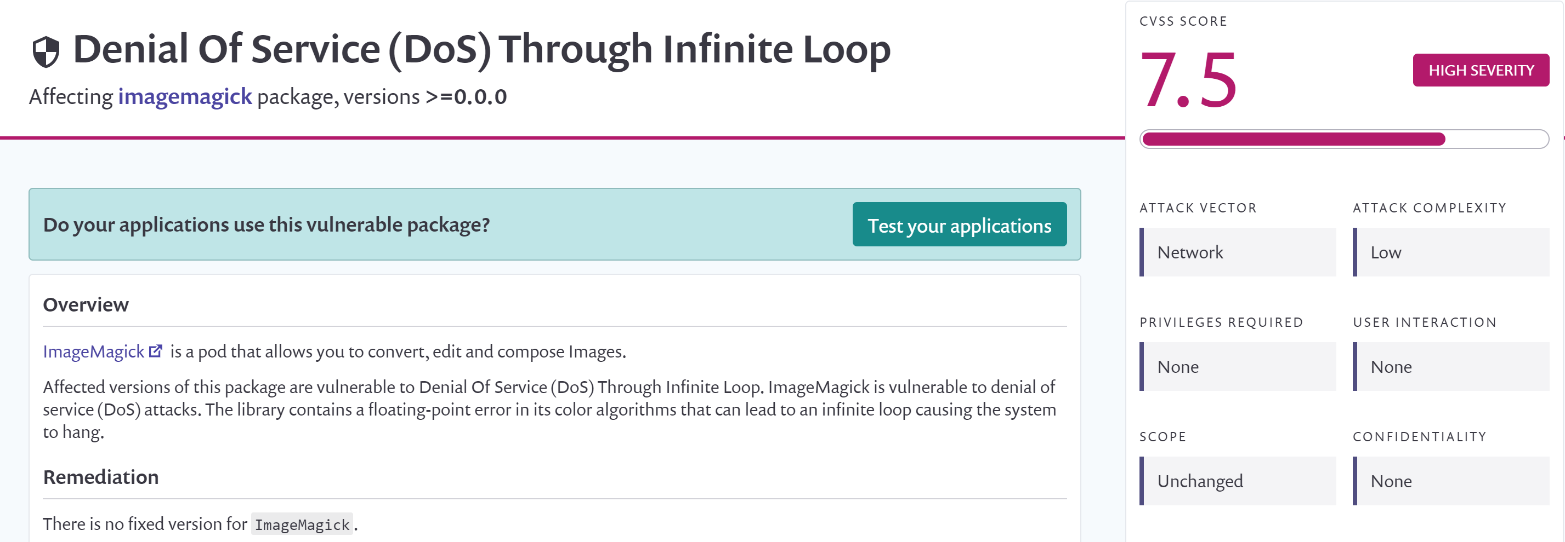
Snyk
Scan your project for security vulnerabilities in third-party dependencies

Slide 3

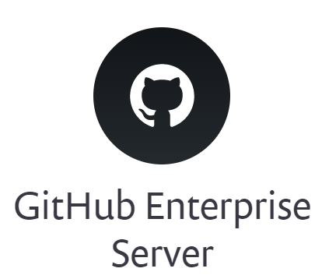
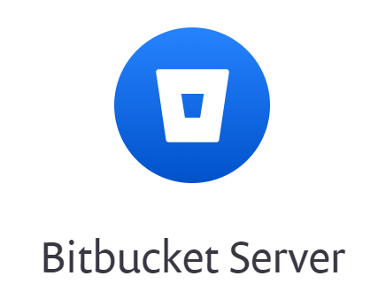
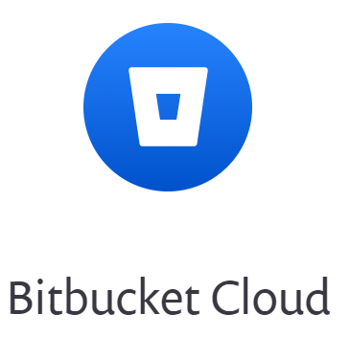

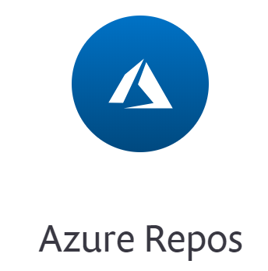
New project
CLI tool
Web interface
Easily create a new project from existing repo

Slide 4
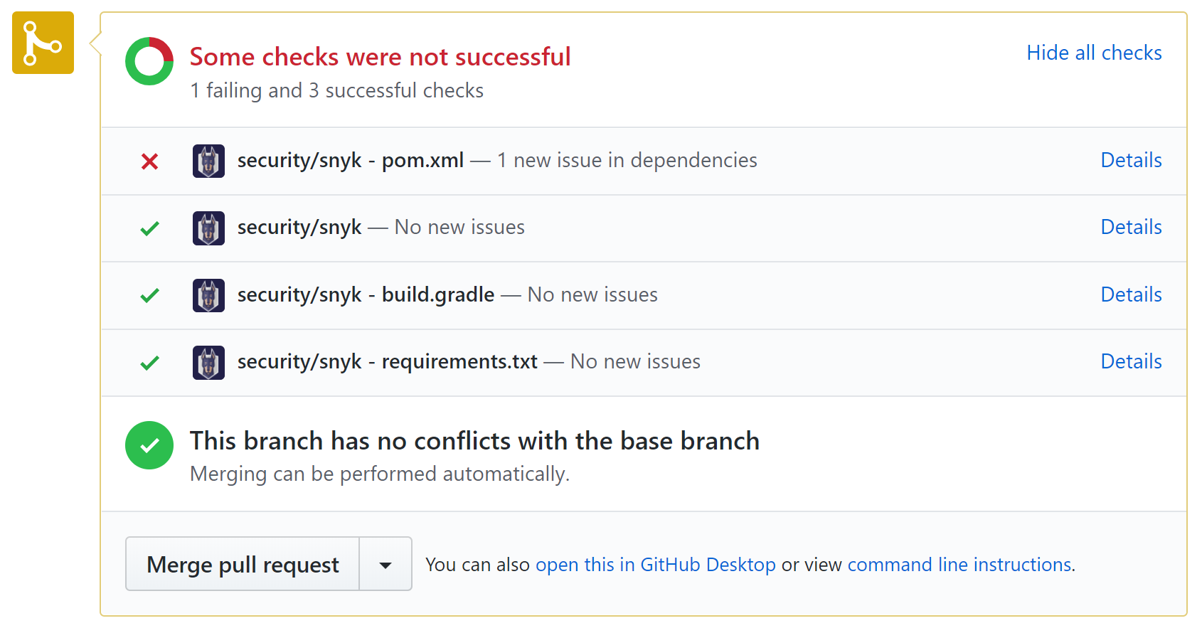
CI Integration
Works well with various Continuous Integration systems
Jenkins, TeamCity, Travis, Bamboo, …
Can break build when new vulnerabilities are found

Slide 5
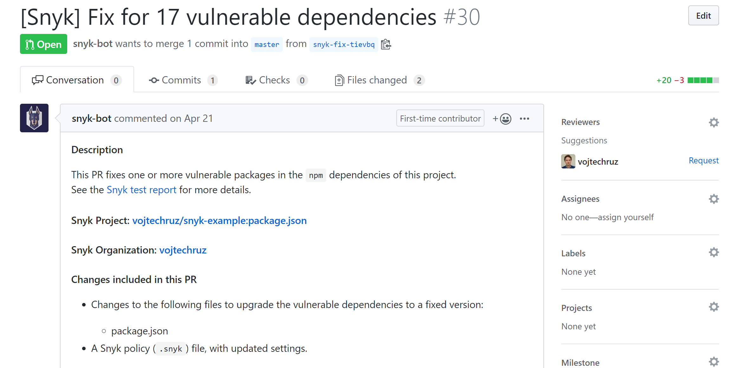
Automatic fixes
Snyk can create automatically pull request with fixes for you
Example PR

Slide 6
Snyk Security Patches
Custom security fixes by Snyk
By Snyk research team
Can fix vulnerabilities before the official new version is available
Backporting fixes to older version if you cannot upgrade
Automatically part of the build process
Currently NPM only
Active security research by Snyk team
Snyk research team discovers severe prototype pollution security vulnerabilities affecting all versions of lodash
Staying ahead of security vulnerabilities with security patches

Slide 7
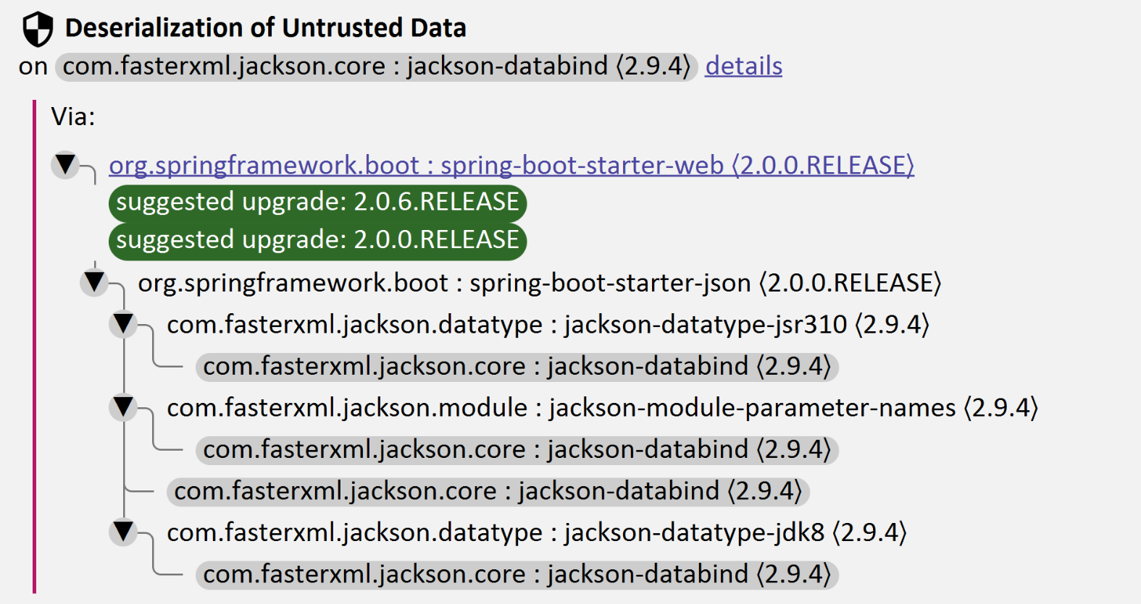
IntelliJ IDEA Integration
IntelliJ IDEA Snyk Plugin
Maven Only
Detecting vulnerable dependencies in IntelliJ IDEA

Slide 8
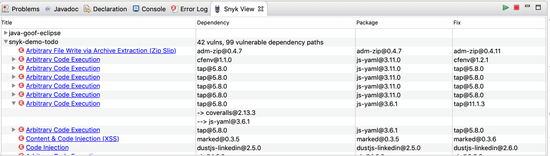
Eclipse Integration
Eclipse Snyk Plugin
Both direct and transitive dependencies
Links to Snyk Vulnerability DB
Fix open source vulnerabilities directly from your Eclipse IDE

Slide 9
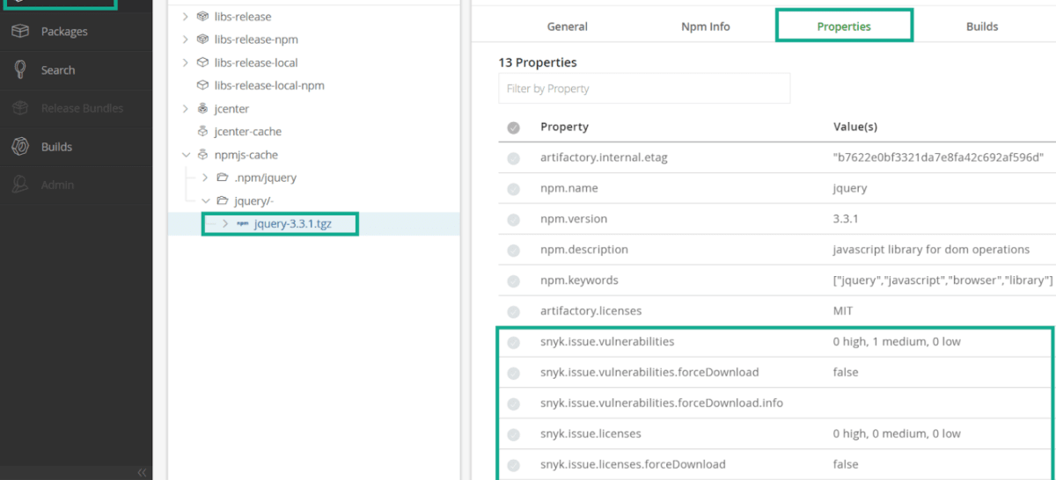
Securing Artifactory
Artiactory Snyk Plugin
Can block downloads of vulnerable artifacts
Can block downloads of artifacts with license issues
Can set tresholds
Securing Artifactory using Snyk

Slide 10
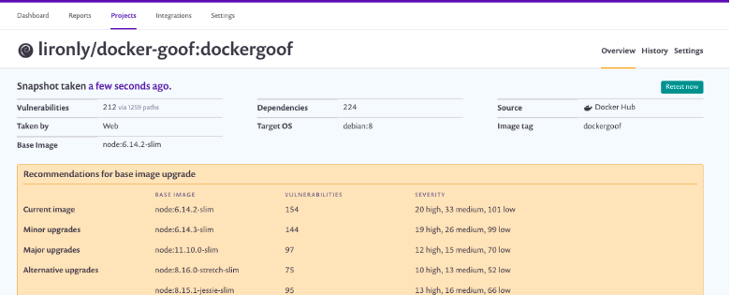
Container Vulnerability Testing
DockerHub, ECR, GCR, ACR
Both on Dockerfile and image level
Scans OS packages – dpkg, rpm, apk
Also scans for some non-managed binaries

Slide 11
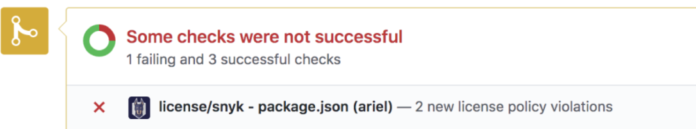
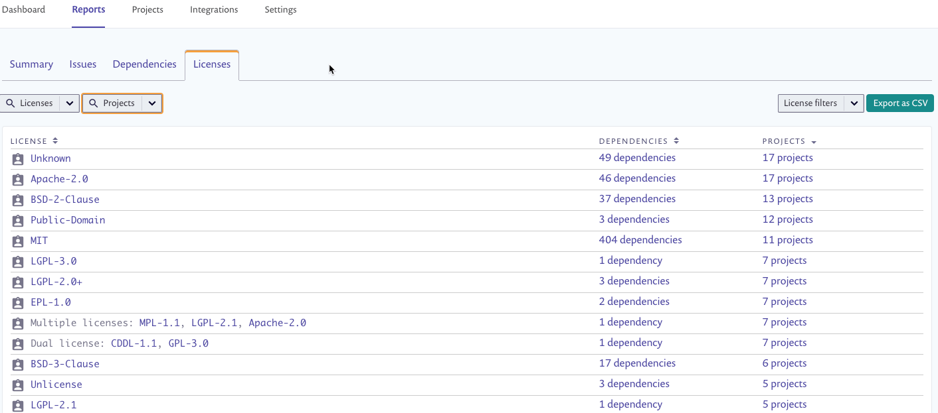
Licensing Compliance Management
Define licensing policies
Severity level of each violation
Automatically detect if dependency violates licensing policy

Slide 12
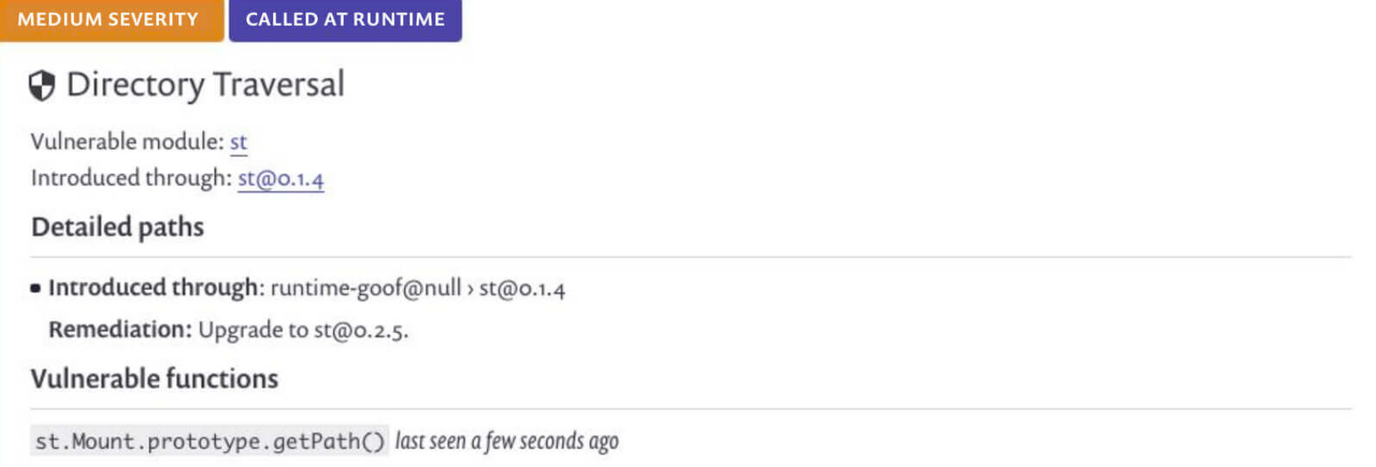
Run-time monitoring
Can detect actual function calls at runtime
Allow you to detect if vulnerable code is actually executed
Uses special instrumentation agent
Java/NPM
Introducing open source security runtime monitoring

Slide 13
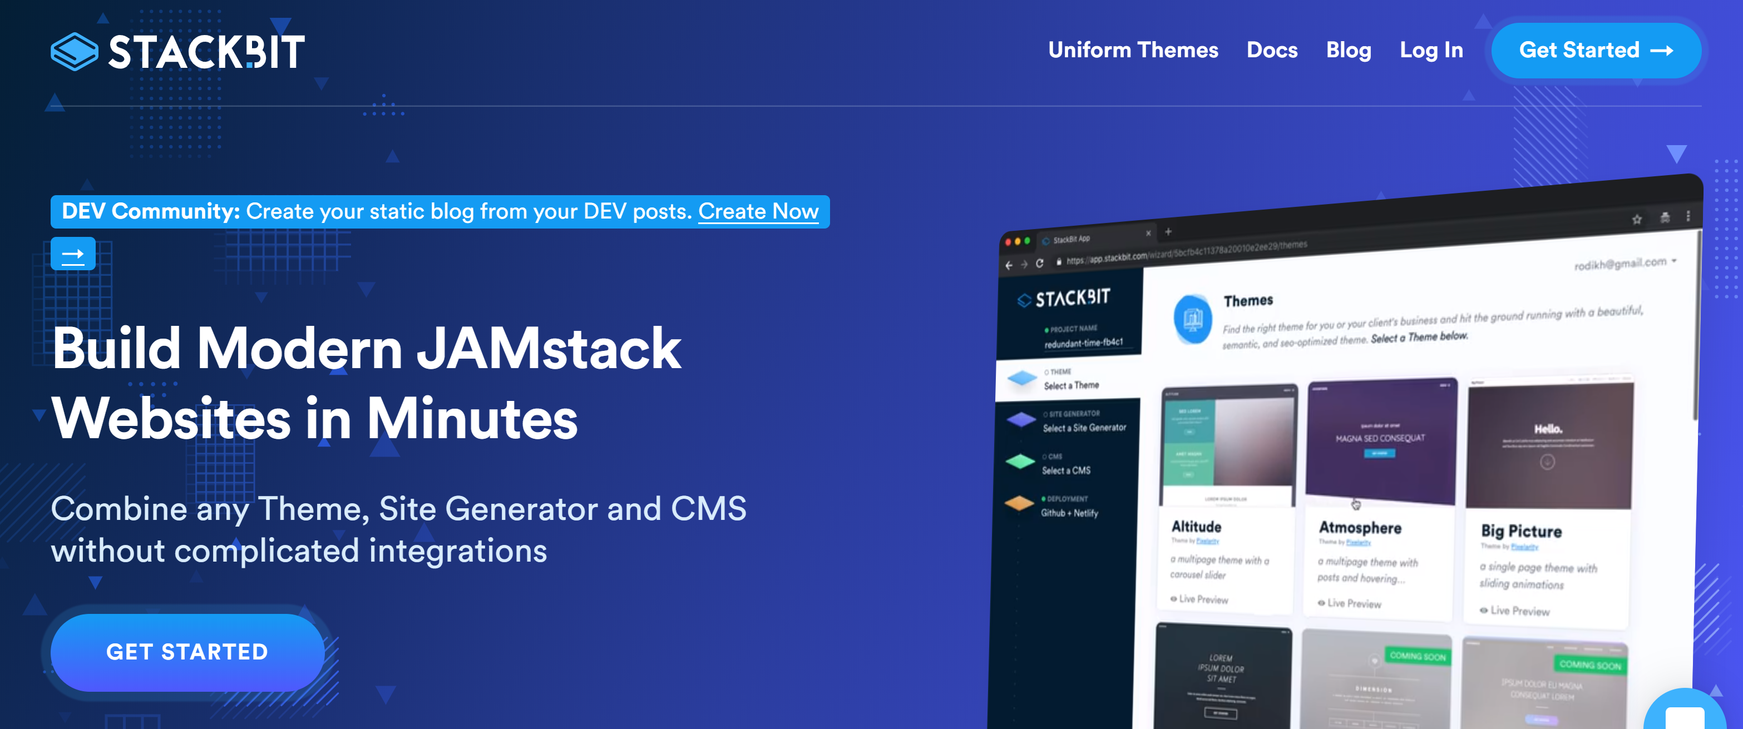

Slide 14


Slide 15
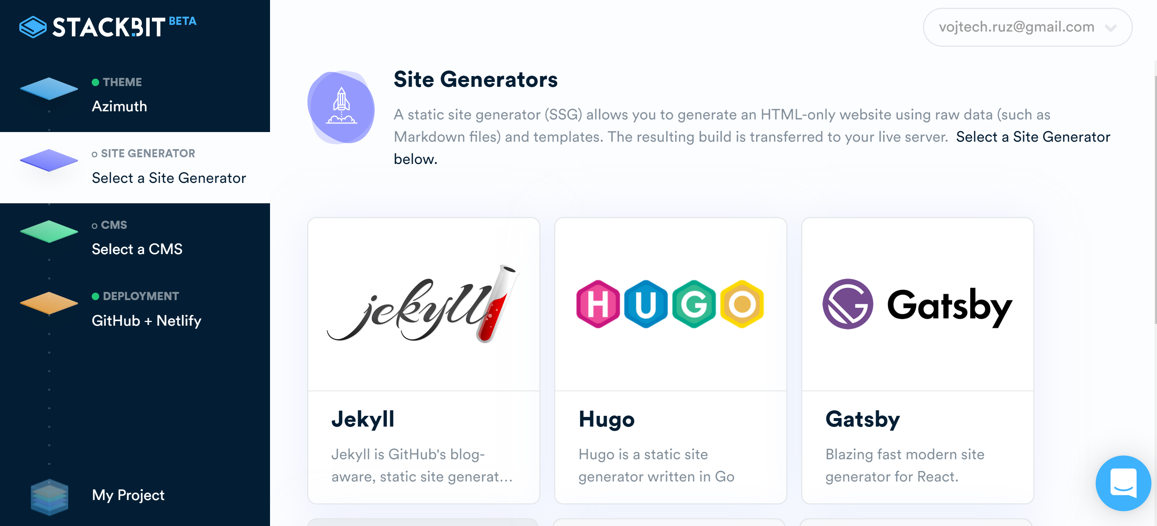

Slide 16
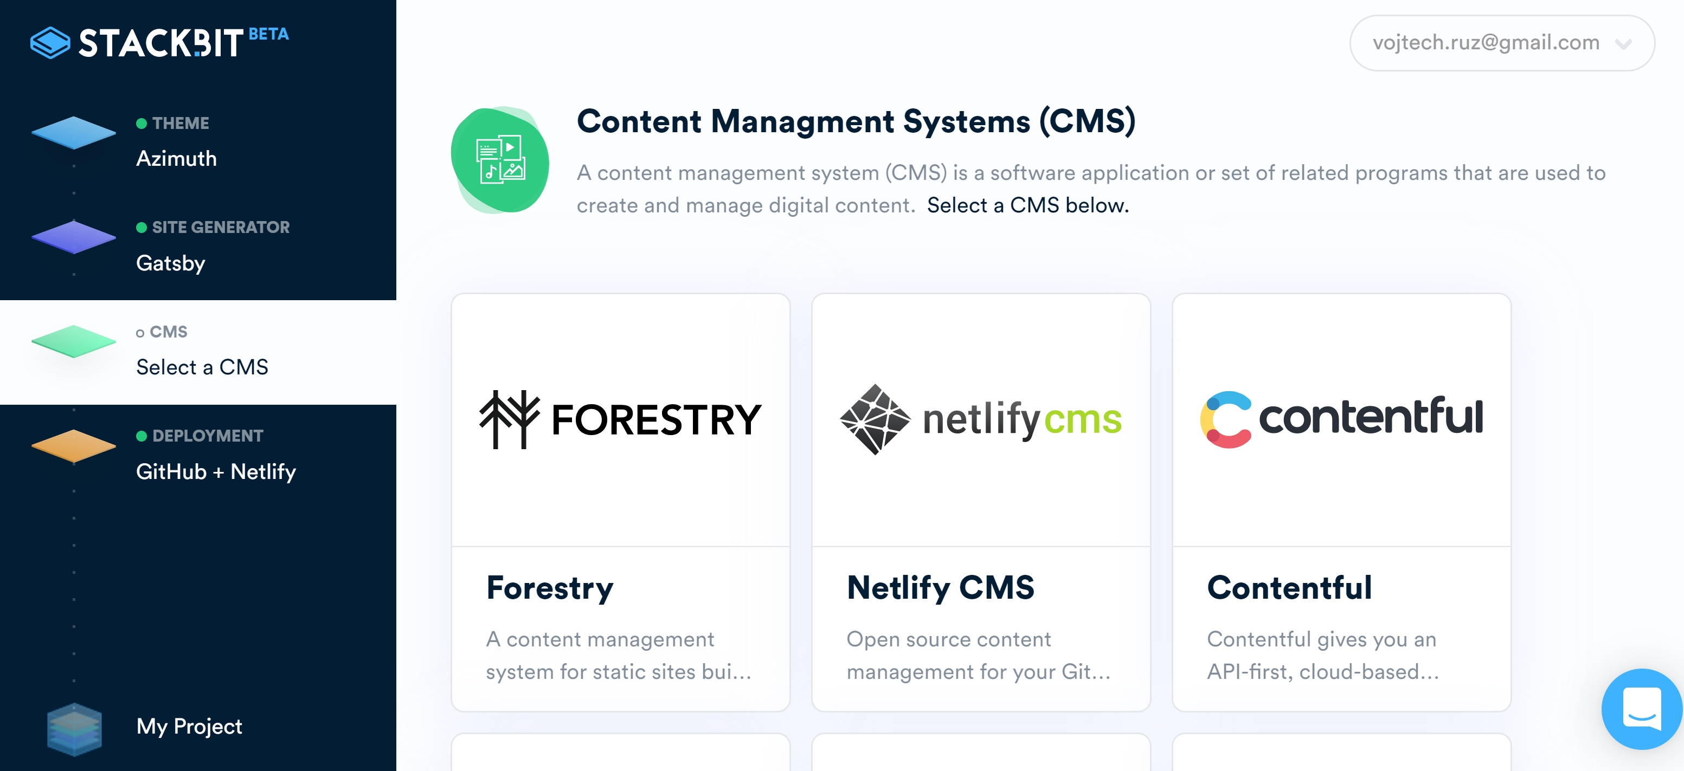

Slide 17
